Slide 1
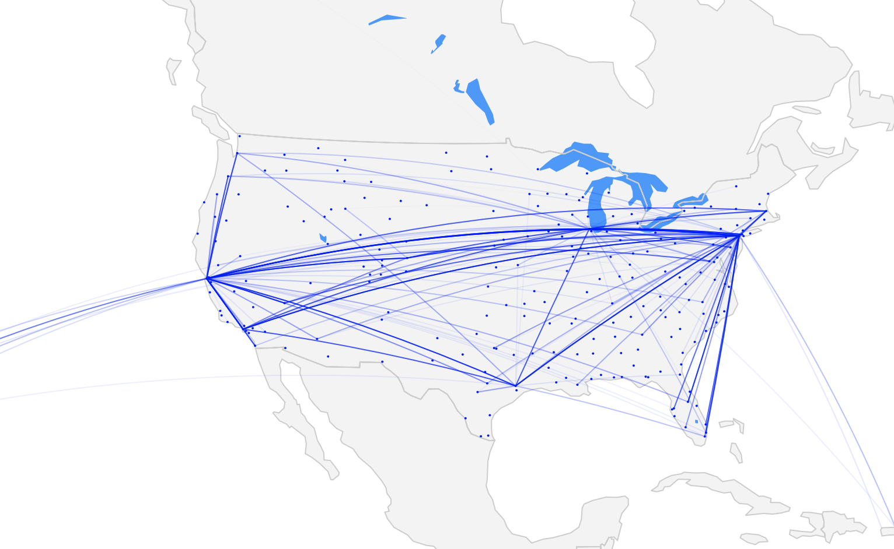
US Airline Performance

Slide 2
Scope
Problem
Explore the Data
Modeling
Results

Slide 3

Problem
Will the flight be delayed or on-time?
Why are flights delayed?
Are 80% of flights really on-time?
Flight delays cost $32.9B ($16.7B cost to passengers alone!)

Slide 4

Explore the Data – Delay Distribution
Distribution of arrival delays is skewed for both long and short flights
LONG FLIGHTS
AVERAGE 2.8 min.
MEDIAN -7 min.
STD 46 min.
SHORT FLIGHTS
AVERAGE 4.9 min.
MEDIAN -6 min.
STD 45.8 min.

Slide 5
Explore the Data – Airline Performance
Distribution of arrival delays by airline

Slide 6
Explore the Data – Delays by Airport
2017
TOP 10 MOST DELAYED AIRPORTS
(PERCENT OF DELAYED FLIGHTS)
EWR 0.25
SFO 0.24
JFK 0.24
LAX 0.22
LGA 0.21
BOS 0.21
DFW 0.20
ORD 0.20
LAS 0.19
MCO 0.19

Slide 7
Explore the Data – NYC vs National Avg.
NAS
NYC Delays
National Delays

Slide 8
Explore the Data – NYC Performance
Distribution of arrival delays by airport

Slide 9
Explore the Data – NYC Flight Volume

Slide 10
Explore the Data – NYC Schedule

Slide 11

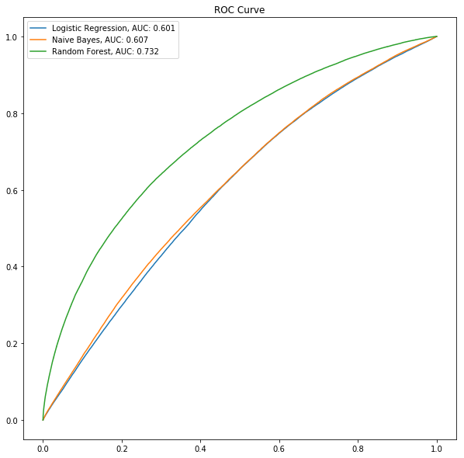
Modeling – Initial Models
Logistic Regression |  | Actual
 |  | On-time | Delayed
Predicted | On-time | 401,109 | - | 401,109
 | Delayed | 90,673 | - | 90,673
 |  | 491,782 | -
Naïve Bayes |  | Actual
 |  | On-time | Delayed
Predicted | On-time | 401,109 | - | 401,109
 | Delayed | 90,673 | - | 90,673
 |  | 491,782 | -
Random Forest |  | Actual
 |  | On-time | Delayed
Predicted | On-time | 399,344 | 1,765 | 401,109
 | Delayed | 86,270 | 4,403 | 90,673
 |  | 485,614 | 6,168

Slide 12
Modeling – Feature Engineering
Hourly buckets for departures and arrivals
Direction of flight
Weather (precipitation, visibility, wind, temperature)
Origin flight volume during scheduled departure
Monthly passenger loading data

Slide 13
Modeling – Improving Random Forest

Slide 14

Results
Precision = 269,557 299,732 = 0.90
False Positive Rate = 131,552 / 90,673 = 1.45
True Negative Rate = 60,498 / 90,673 = 0.67 (Delayed Prediction Rate)
Recall = 269,557 / 401,109 = 0.67 (On-time Prediction Rate)
Tuned Model and Final Weights Added 1:4.85 |  | Actual
 |  | On-time | Delayed
Predicted | On-time | 269,557 | 131,552 | 401,109
 | Delayed | 30,175 | 60,498 | 90,673
 |  | 299,732 | 192,050

Slide 15
Results – Next Steps
Add Features – Plane information data form FAA
Add Features – Plane maintenance history
Add Features – Historical route performance
Expand Flight Data – Add other years’ data for training
Expand Models – Introduce Neural Networks

